Slide 1
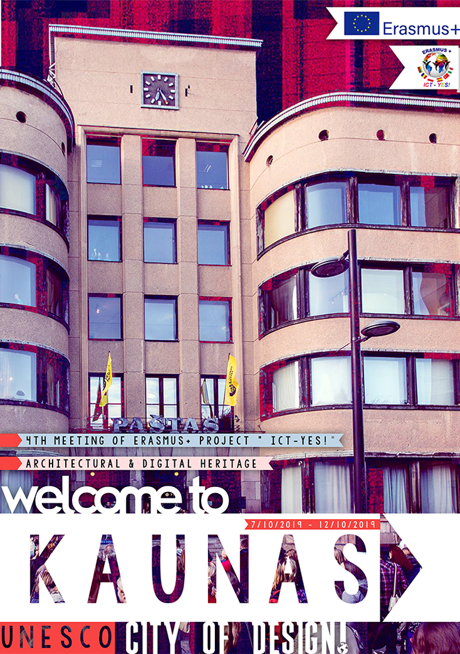

Slide 2
History
Contemporary Kaunas wouldn’t exist without the time when the city served as the temporary capital of Lithuania from 1919 till 1940. Overnight Kaunas had to transfer from a little town to the capital that meets the European standard.
For various reasons different professionals from other countries started coming to Kaunas and it helped the city to arise almost overnight.

Slide 3
Central Post Office
This building is distinguished by an organic combination of nationality and modernism. People hope that in the future the Post Office can be converted to a cultural place open to the public.
Architect: Feliksas Vizbaras, 1931

Slide 4
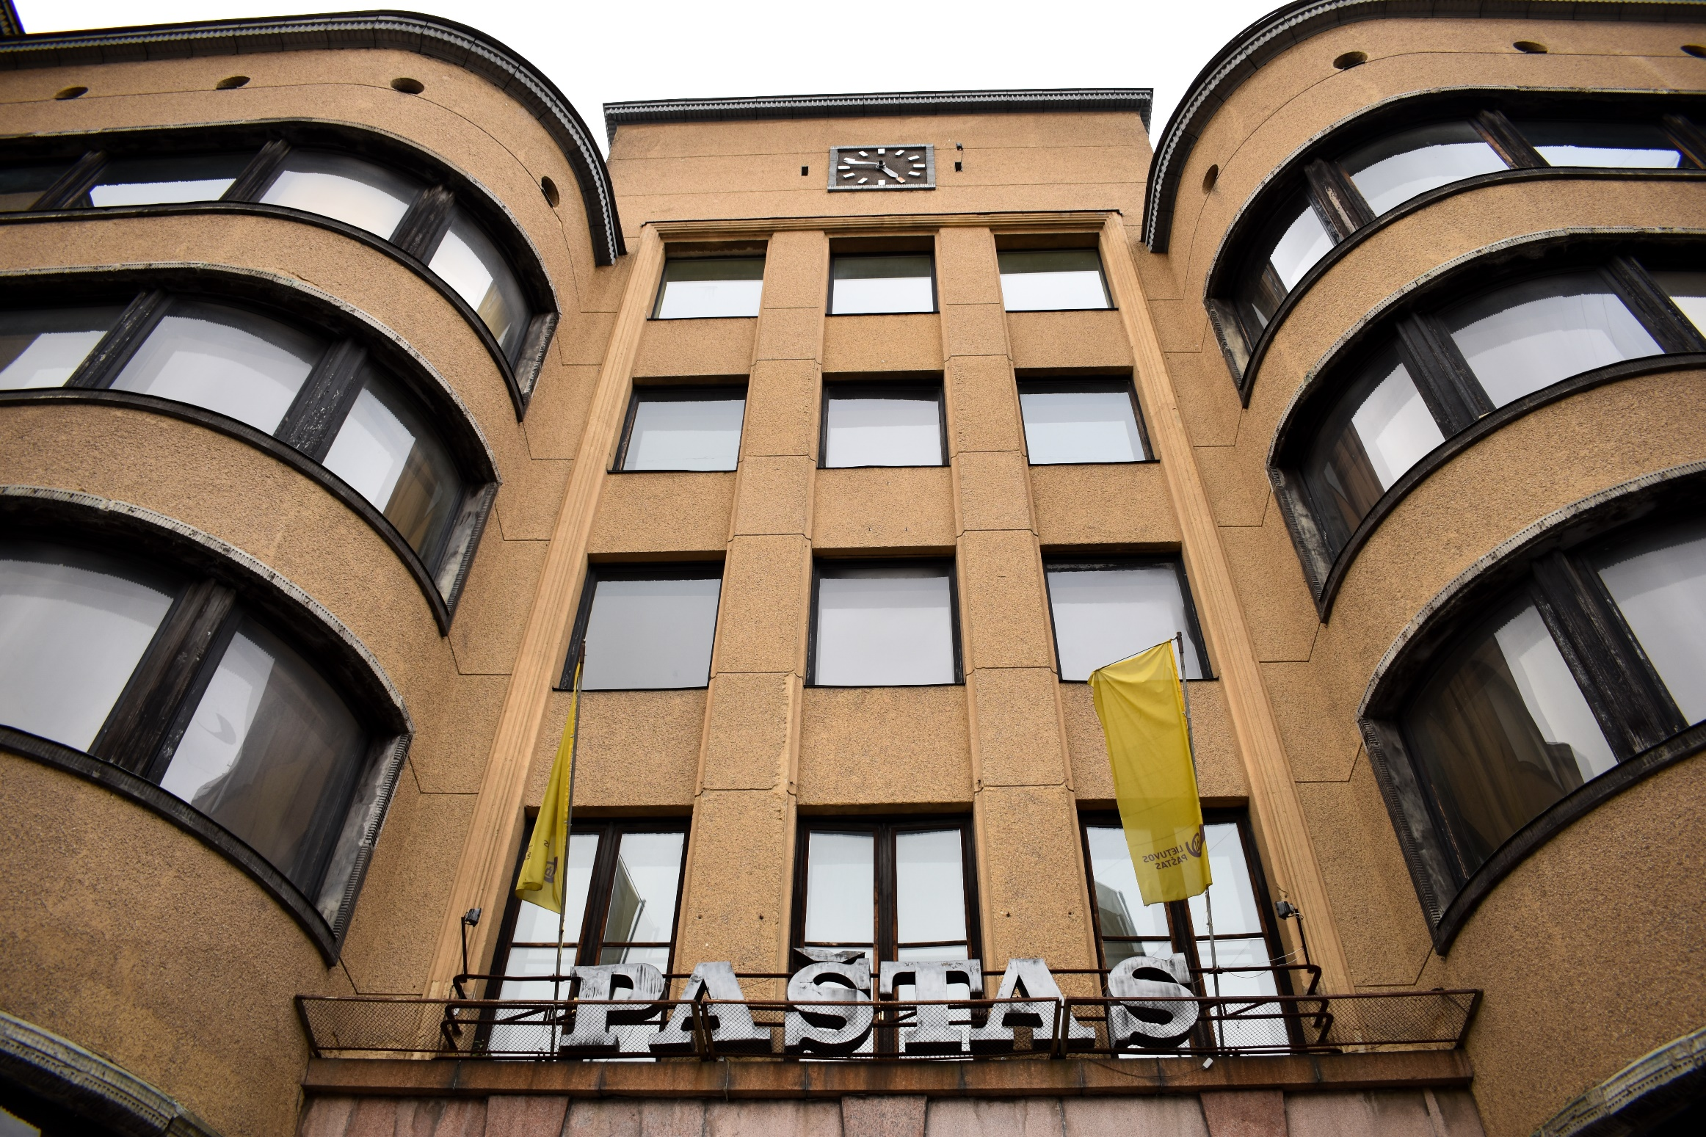

Slide 5
Dairy Centre
The inventive simplicity and multifunctionality that were squeezed in this narrow corner lot, seem to have gone ahead of their time. After university students moved out, the Dairy Centre comes to life only during special occasions.
Architect: Vytautas Landsbergis- Žemkalnis, 1932

Slide 6
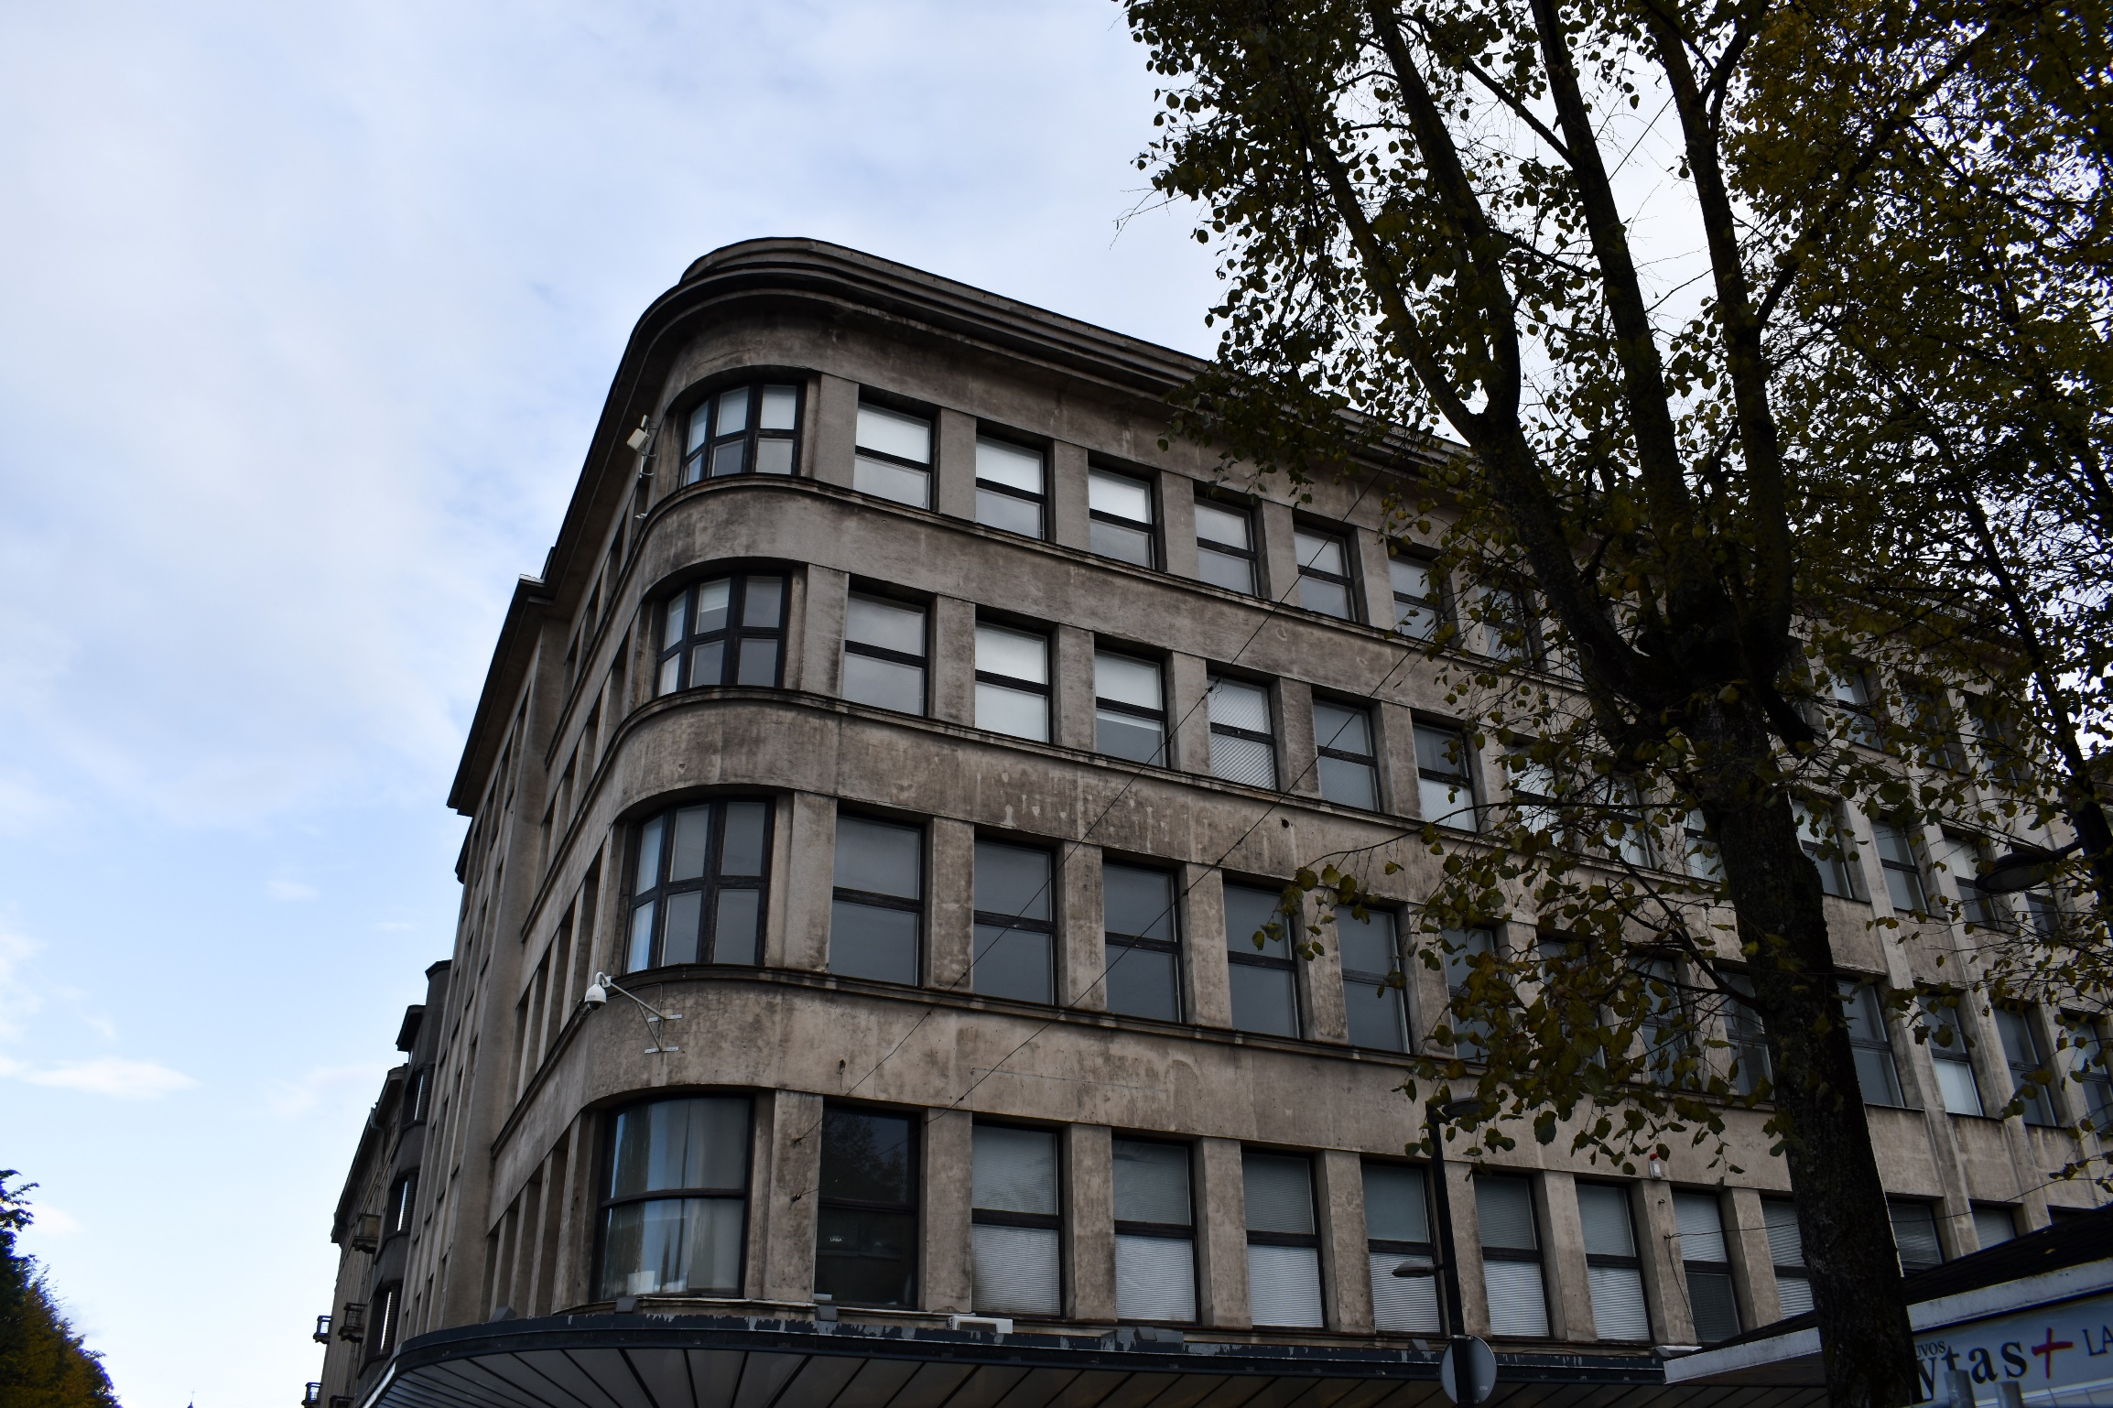

Slide 7
Sports Hall
In 1937, after Lithuanians won the European Championship, basketball became so popular that it was decided that the championship of 1939 will be held in Kaunas. It was supposed to be the first basketball arena on the continent so a lot of architects said no, but one said yes to this project. And now all Kaunas Žalgiris fans are grateful to him.
Architect: Anatolijus Rozenbliumas, 1939

Slide 8
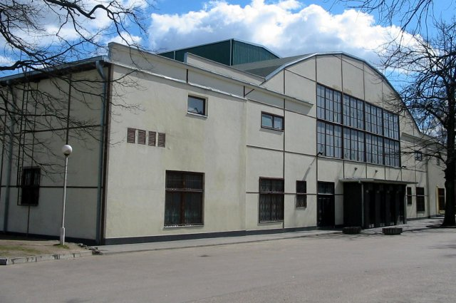

Slide 9
Karininkų Ramovė/ Officers‘ Club
The exterior of the building takes your breath away with its subtle and still relevant ethnic features. The interior is full of ethnic symbols too.
Architects: Stasys Kudokas, Kazys Kriščiukaitis, 1937

Slide 10
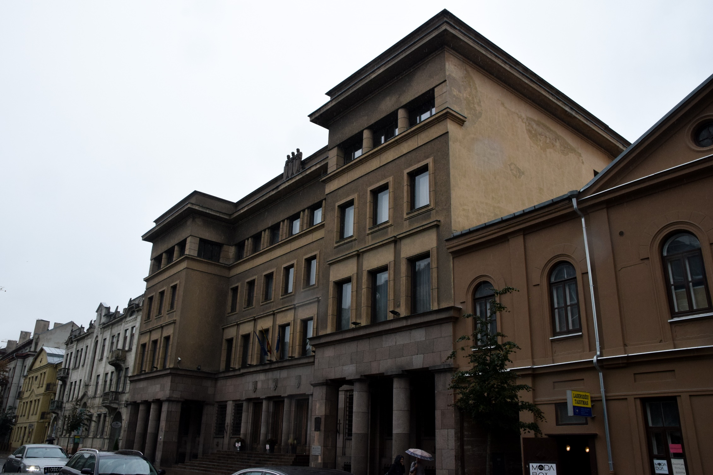

Slide 11
Vytautas the Great War Museum and M. K. Čiurlionis National Museum of Art
Not all Kaunas visitors know that the two largest museums of the city are located in one building! The building descended in the temporary capital, is too big for visitors to examine in one day. Also, War Museum garden is the heart of statehood inspired by French and Italian examples.
Architects: Vladimiras Dubeneckis, Karolis Reisonas, Kazys Kriščiukaitis, 1936

Slide 12
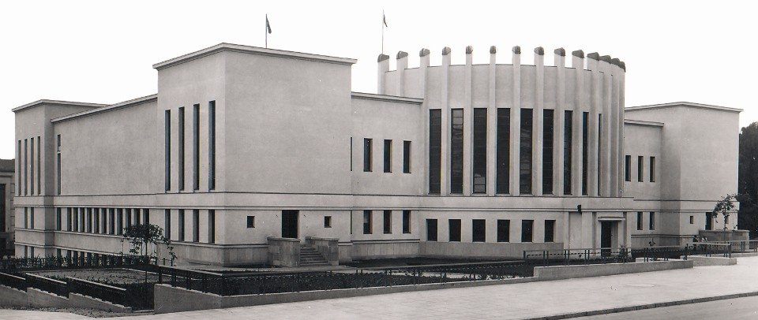

Slide 13
Aleksotas Funicular
It’s a miracle that two funiculars- the symbols of a modern city in the interwar period- not only remained intact but are still used to this day.
1935

Slide 14
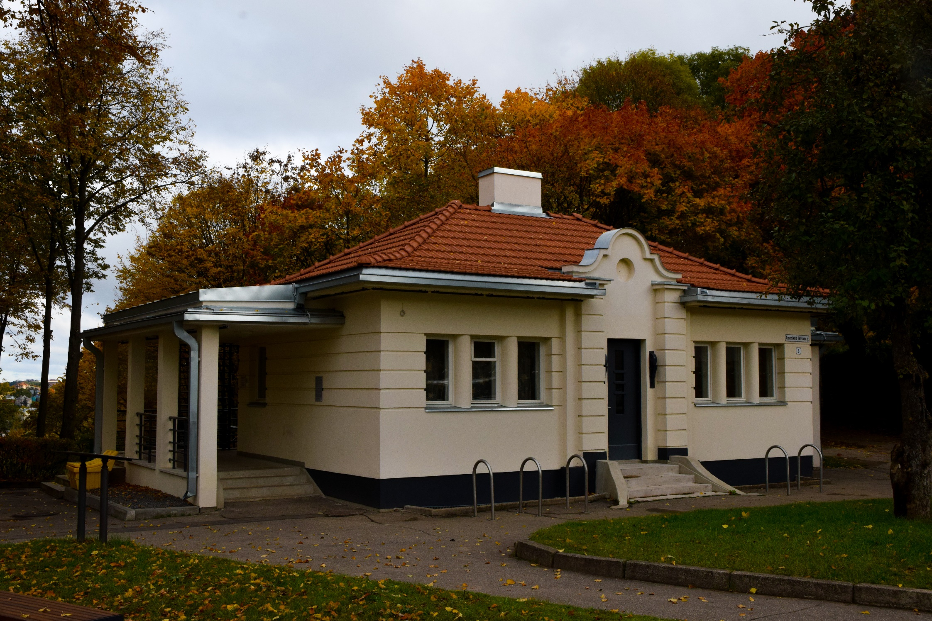

Slide 15
Christ‘s Resurrection Church
It seems that the prolonged construction of this symbol of independent and strong Lithuania gives sense to its purpose. The church construction process was interrupted by the Soviet occupation (almost 50 years the church was a radio engineering factory). The Latvian- born architect of the church had converted to Catholicism for this project.
Architect: Karolis Reisonas, 1933- 2004

Slide 16
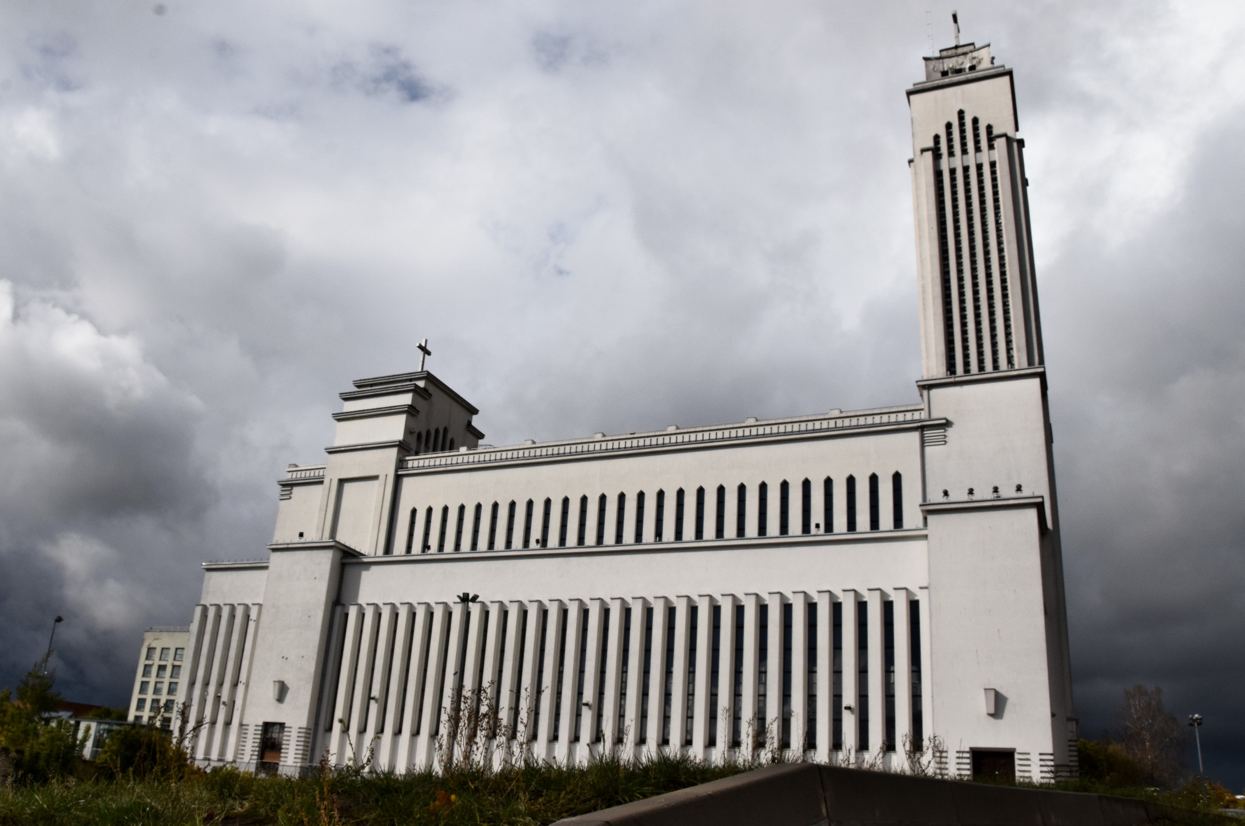

Slide 17
Notary Kazimieras Škėma apartment building
In the building you can see the 4th decade modernism of Lithuania. The building is an upside- down letter T but the most important things are bay windows and the balconies you see in the front.
Architects: Bronius Elsbergas, Klaudijus Dušauskas, 1933

Slide 18
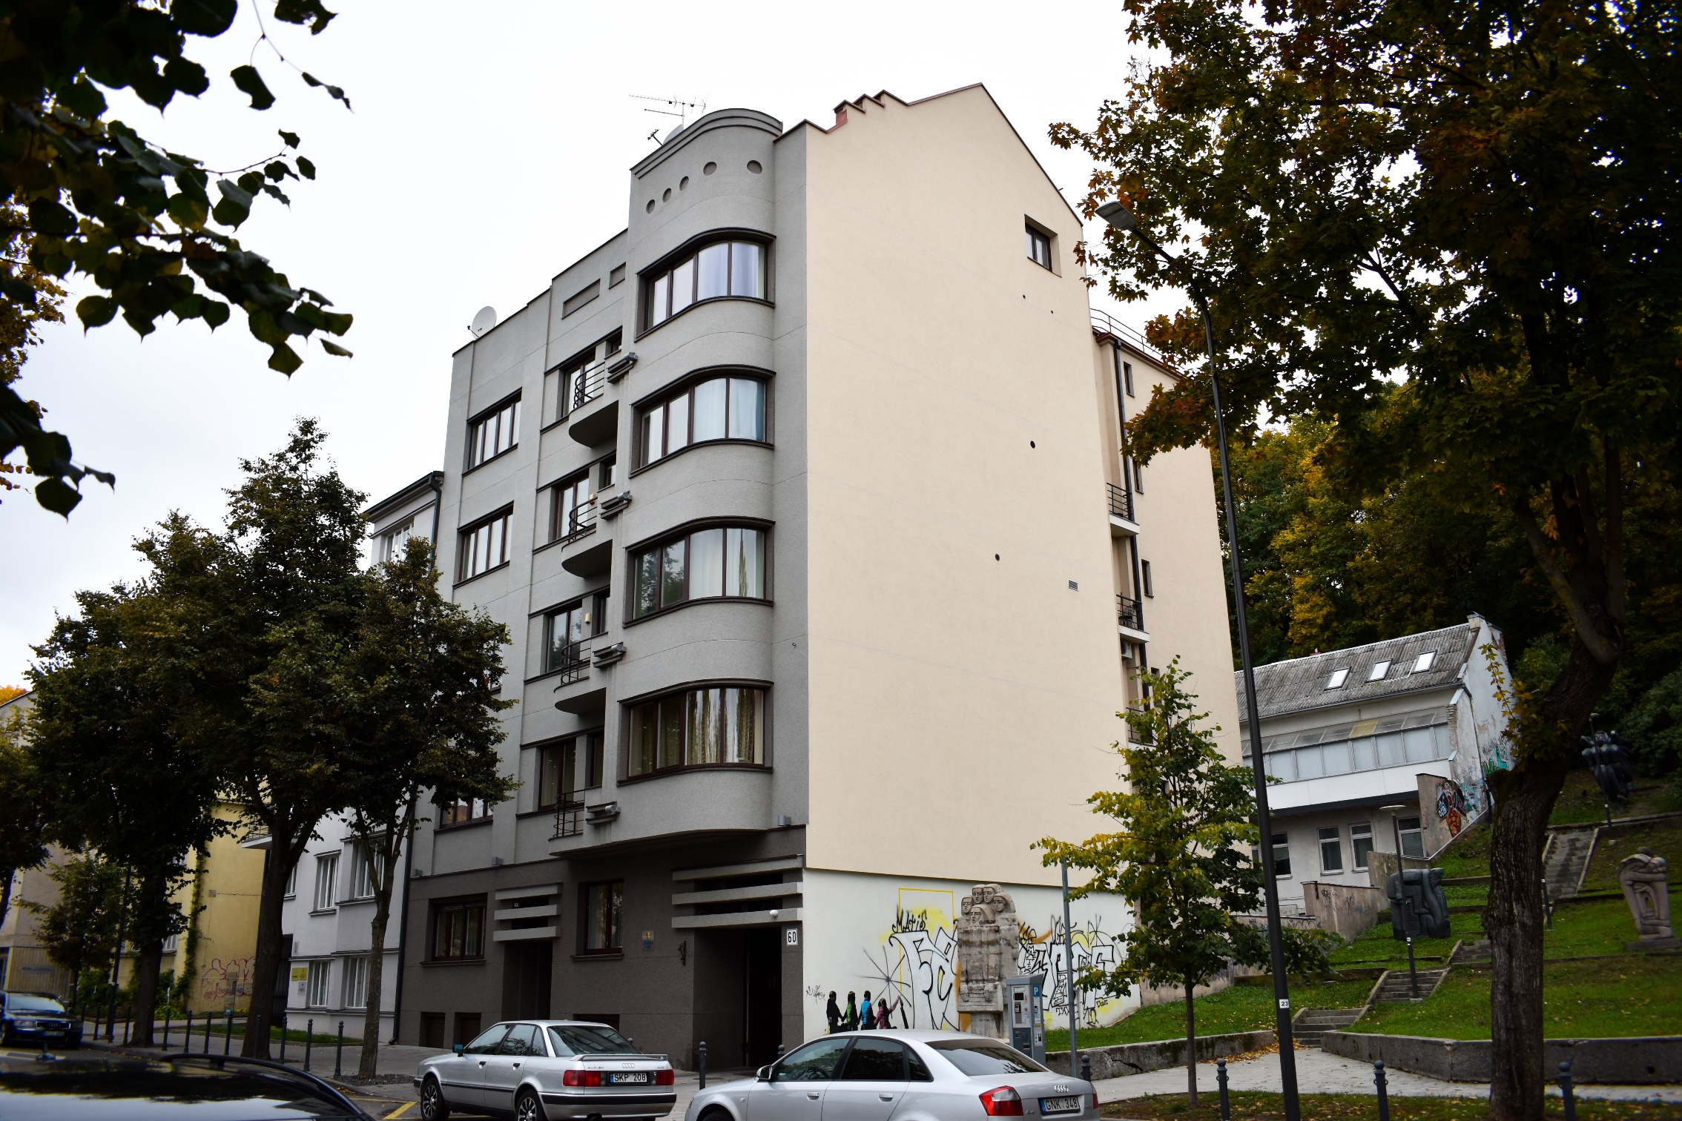

Slide 19
Žaliakalnis Waterworks
The water- supply station- a sign of a real city- is decorated with a sculpture: The Water Carrier. Also Kaukas stairs are located closely and they can take you to the city centre, but sadly their authenticity was destroyed during the war.
Architect: Stasys Kudokas, Sculptor: Bronius Pundzius, 1938

Slide 20
